Slide 1
CIND 820 Big Data Analytics Project Credit Card Fraud Detection
By: Gaurang Dadu
#501262373

Slide 2

Objectives
Algorithm Comparison:
Evaluate Random Forest, Decision Tree, and Logistic Regression.
Compare accuracy, precision, recall, and confusion matrix.
Class Imbalance and SMOTE:
Investigate class imbalance impact in fraud datasets.
Assess SMOTE effectiveness for a balanced fraud detection model.
Real-Time Fraud Detection:
Extract insights for real-time fraud detection system development.
Offer practical implications for financial institutions.

Slide 3
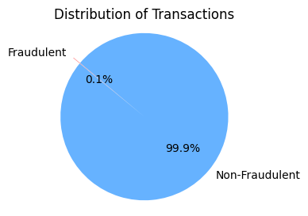
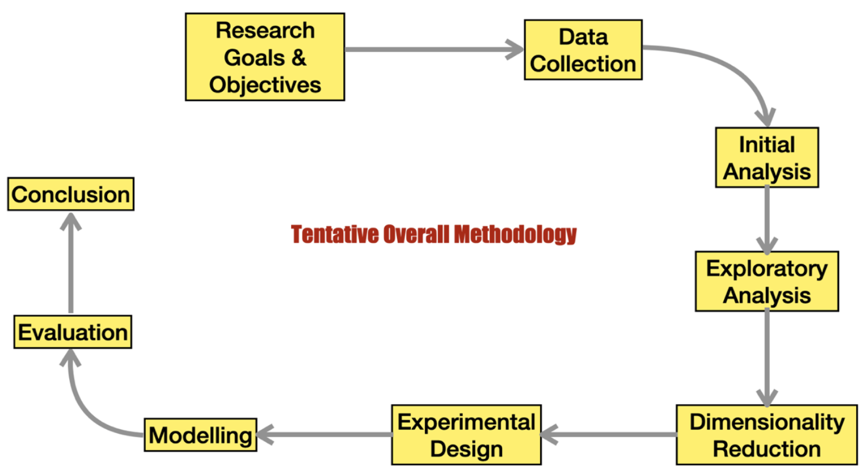
Data Source & Methodology
The project relies on a publicly available credit card transaction dataset sourced from Kaggle. With over 6 million rows and 11 variables, this dataset provides ample data for training and testing machine learning models.
Highly imbalanced dataset. Only 8213 Fraud transactions out of 6.3 million total transactions.

Slide 4
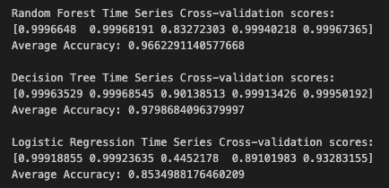
Comparative Analysis of Machine Learning Algorithms
Research Question: How do different ML algorithms compare?
Timed Cross-validation reveals Decision Tree as the best performing model with 97.98% Accuracy.

Slide 5
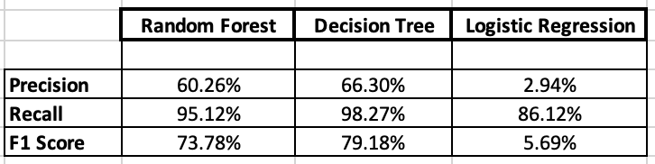
Other Evaluation Parameters
Precision: Indicates the accuracy of positive predictions.
Recall: Measures the ability to capture all positive predictions.
F1 Score: Provides a mean of precision and recall by considering both false positives and false negatives.
Confusion matrix: A tabular visualization of the performance of classification algorithm which counts the number of true positives, true negative, false positive and false negative predictions.
AUC (Area Under the Curve): It summarizes the performance of a classification model by assessing the are under the ROC curve, indicating the model’s ability to distinguish between classes.

Slide 6
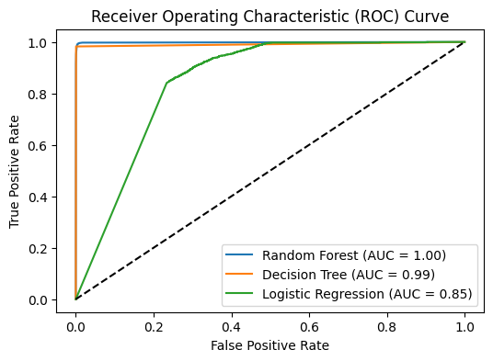
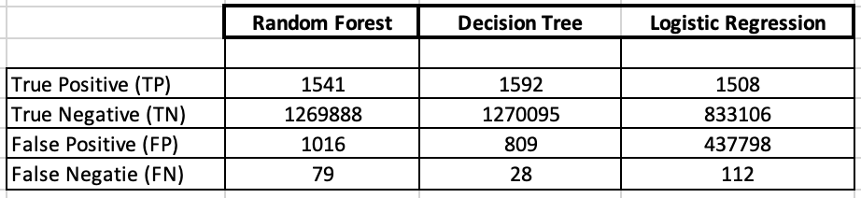
Confusion Matrix and AUC Results:
The Decision Tree model demonstrates superior performance in credit card fraud prediction, achieving the highest accuracy (97.98%) and F1 score (79.18%) among the evaluated models. This indicates its effectiveness in balancing precision and recall for accurate fraud detection in the dataset.

Slide 7
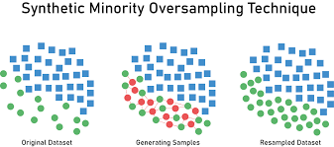
Impact of Class Imbalance and SMOTE Techniques
Research Question: Examining the Influence of Class Imbalance and SMOTE.
Challenges of Class Imbalance:
Class imbalance in credit card fraud datasets poses challenges by biasing models toward the majority class.
Imbalanced datasets can lead to suboptimal fraud detection and misclassification of minority class instances.
SMOTE Technique Explanation:
Synthetic Minority Over-sampling Technique (SMOTE) addresses class imbalance by generating synthetic examples of the minority class.
SMOTE enhances the dataset's balance, preventing the model from favoring the majority class and improving fraud detection accuracy.

Slide 8
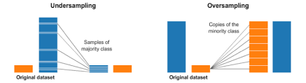
Balancing the dataset is crucial for accurate model performance. Initial imbalances led to inflated accuracy, which is unrealistic.
Selecting oversampling with SMOTE ensures comprehensive learning from both classes without losing non-fraud transaction information, enhancing the model's realism and robustness.
This choice aims to address challenges posed by class imbalance in credit card fraud datasets.

Slide 9

Contribution to Real-Time Fraud Detection Systems:
Research Findings:
Anomalies in Transaction Times: Significant fraud incidents clustered around midnight, highlighting the need for enhanced vigilance during these hours.
High-Risk Transaction Types: Certain types, especially cash-out and transfers, exhibited a higher propensity for fraud, emphasizing the necessity of focused monitoring.
Practical Implications:
Tailored Security Measures: Institutions can implement specific security measures targeting high-risk transaction types and vulnerable time periods.
Multi-Layered Authentication: The recommendation for enhanced authentication during high-risk hours provides an additional safeguard against fraudulent activities.

Slide 10

Conclusion
Key Research Questions:
Addressed the comparative analysis of machine learning algorithms (Random Forest, Decision Tree, Logistic Regression).
Explored the impact of class imbalance and assessed the effectiveness of SMOTE.
Contributed insights for real-time fraud detection systems and translated cross-validation results into practical recommendations.
Techniques Employed:
Utilized Random Forest, Decision Tree, and Logistic Regression for algorithm comparison.
Applied SMOTE for addressing class imbalance in credit card fraud datasets.
Conducted timed cross-validation for model evaluation.

Slide 11
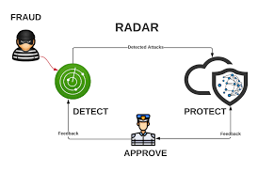
Key Findings:
Comparative analysis highlighted strengths and weaknesses of each algorithm.
SMOTE proved effective in mitigating class imbalance challenges.
Insights for real-time fraud detection systems and actionable recommendations were identified.
Limitations:
Dataset limitations, including fewer attributes and inherent class imbalance.
Computational constraints influenced model choice and processing times.
Areas for Improvement:
Future work could involve collecting more detailed transaction attributes.
Consideration of alternative balancing techniques beyond SMOTE.
Exploration of advanced models with increased computing power.

Slide 12
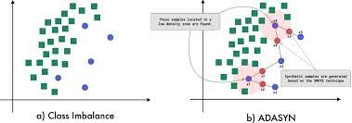
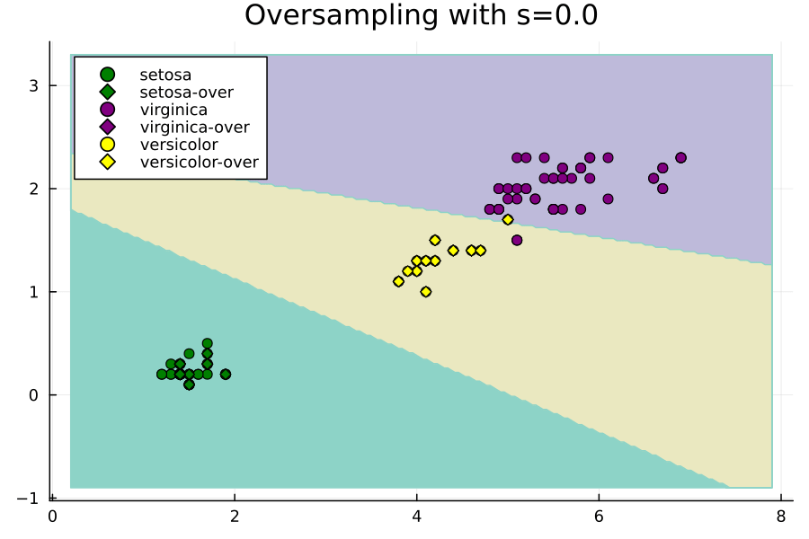
Recommendations for future work:
Enhance dataset attributes for more robust feature engineering like including Date and Time.
Investigate advanced balancing techniques for improved model performance like ADSYN (Adaptive Synthetic Sampling) and Random Oversampling Examples (ROSE).
Employ powerful computing resources for intricate model architectures.

Slide 13


Slide 14
Thank you!

